Slide 1


Unit – 10 List, Stacks, Queues and Priority Queues
Prepared By
Prof. Ravikumar Natarajan
Assistant Professor, CE Dept.

Slide 2
Contents
Collection
Iterators
Lists
The Comparator interface
Static methods for list and collections
Vector and Stack classes
Queues and priority Queues

Slide 3
Introduction
A data structure is a collection of data organized in some fashion.
The structure not only stores data but also supports operations for accessing and manipulating the data.
In object-oriented thinking, a data structure, also known as a container or container object, is an object that stores other objects, referred to as data or elements.
To define a data structure is essentially to define a class.
The class for a data structure should use data fields to store data and provide methods to support such operations as search, insertion, and deletion.

Slide 4
Introduction
To create a data structure is therefore to create an instance from the class.
You can then apply the methods on the instance to manipulate the data structure, such as inserting an element into or deleting an element from the data structure.
Choosing the best data structures and algorithms for a particular task is one of the keys to developing high-performance software.

Slide 5
Collections
The Java Collections Framework supports two types of containers:
One for storing a collection of elements is simply called a collection.
The other, for storing key/value pairs, is called a map (efficient for searching).
The common features of collections are defined in the interfaces, and implementations are provided in concrete classes (normal class).
The Collection interface defines the common operations for lists, vectors, stacks, queues, priority queues, and sets.

Slide 6
Collections
Sets store a group of nonduplicate elements.
Lists store an ordered collection of elements.
Stacks store objects that are processed in a last-in, first-out LIFO fashion.
Queues store objects that are processed in a first-in, first-out FIFO fashion.
PriorityQueues store objects that are processed in the order of their priorities.

Slide 7
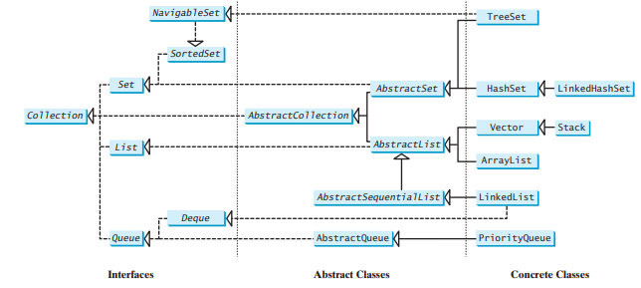
Collections
A collection is a container that stores objects.

Slide 8
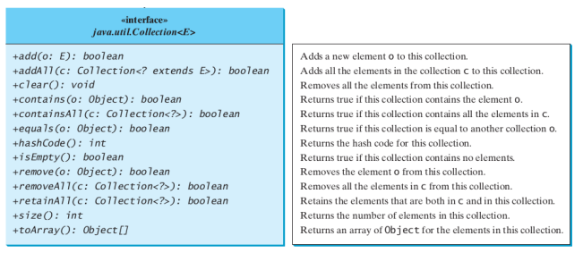
Collection Interface

Slide 9
Iterators
Iterator is a classic design pattern for walking through a data structure without having to expose the details of how data is stored in the data structure.
The Collection interface extends the Iterable interface.
The Iterable interface defines the iterator method, which returns an iterator.
The Collection interface contains the methods for manipulating the elements in a collection, and you can obtain an iterator object for traversing elements in the collection.

Slide 10
Iterators
Iterator is a classic design pattern for walking through a data structure without having to expose the details of how data is stored in the data structure.
The Collection interface extends the Iterable interface.
The Iterable interface defines the iterator method, which returns an iterator.
The Collection interface contains the methods for manipulating the elements in a collection, and you can obtain an iterator object for traversing elements in the collection.

Slide 11
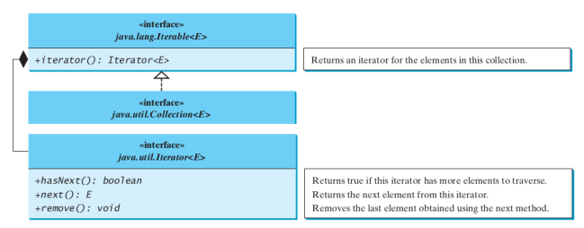
Iterators

Slide 12
Iterators
import java.util.*;
public class Main {
public static void main(String[] args) {
Collection<String> collection = new ArrayList<>();
collection.add("New York");
collection.add("Atlanta");
collection.add("Dallas");
collection.add("Madison");
Iterator<String> iterator = collection.iterator();
while (iterator.hasNext()) {
System.out.print(iterator.next().toUpperCase() + " ");
}
System.out.println(); } }
Output:
NEW YORK ATLANTA DALLAS MADISON

Slide 13
Lists
The List interface extends the Collection interface and defines a collection for storing elements in a sequential order.
To create a list, use one of its two concrete classes: ArrayList or LinkedList.
The List interface adds position-oriented operations, as well as a new list iterator that enables the user to traverse the list bidirectionally.

Slide 14
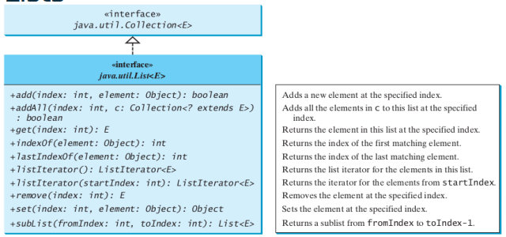
Lists

Slide 15
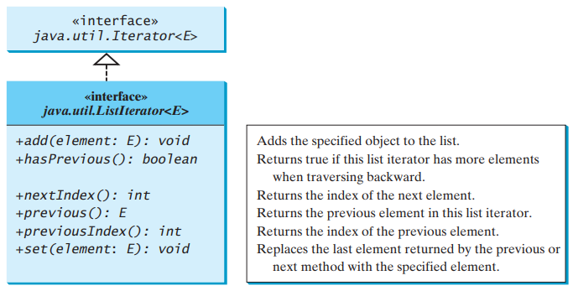
List Iterator
The listIterator() or listIterator(startIndex) method returns an instance of ListIterator.
The ListIterator interface extends the Iterator interface to add bidirectional traversal of the list.

Slide 16
Iterator vs List Iterator
Iterator can traverse only in forward direction whereas ListIterator traverses both in forward and backward directions.
Using Iterator we cannot modify or replace elements present in Collection. But, ListIterator can modify or replace elements with the help of set(E e).
Iterator methods are next(), remove(), hasNext() whereas ListIterator methods are next(), previous(), hasNext(), hasPrevious(), add(E e).

Slide 17
The ArrayList and LinkedList Classes
The ArrayList class and the LinkedList class are two concrete implementations of the List interface.
ArrayList stores elements in an array. The array is dynamically created.
If the capacity of the array is exceeded, a larger new array is created and all the elements from the current array are copied to the new array.
LinkedList stores elements in a linked list. A list can grow or shrink dynamically.
Use of these depends on your specific needs.
List or ArrayList when to choose?
If you need to support random access through an index without inserting or removing elements at the beginning of the list, ArrayList offers the most efficient collection.
If your application requires the insertion or deletion of elements at the beginning of the list, you should choose LinkedList.

Slide 18
The ArrayList and LinkedList Classes
ArrayList is a resizable-array implementation of the List interface.
It also provides methods for manipulating the size of the array used internally to store the list.
Each ArrayList instance has a capacity, which is the size of the array used to store the elements in the list.
As elements are added to an ArrayList, its capacity grows automatically.
An ArrayList does not automatically shrink. You can use the trimToSize() method to reduce the array capacity to the size of the list.

Slide 19
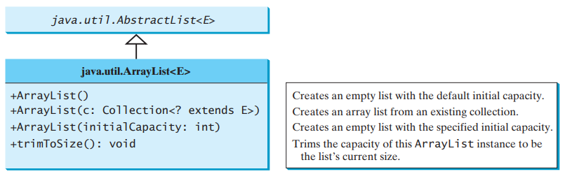
The ArrayList Class
Refer to the example in Slide number: 12

Slide 20
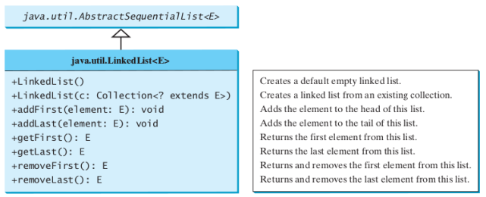
The LinkedList Class

Slide 21
The LinkedList Class
import java.util.*;
class Main{
public static void main(String[] args) {
LinkedList<String> list = new LinkedList<String>();
list.add("Delhi"); list.add(" Moscow");
list.add("NewYork");
System.out.println(list);
list.remove("Moscow");
System.out.println("After Deleting Elements: \n"+ list);
list.remove(1);
System.out.println("After Deleting Elements: \n"+ list);
list.addFirst(“First”);
List.removeLast();
System.out.println("After Deleting Elements: \n"+ list);
} }
Output:
[Delhi, Moscow, NewYork]
After Deleting Elements:
[Delhi, Moscow, NewYork]
After Deleting Elements:
[Delhi, NewYork]
After Add first and remove last Elements:
[First, Delhi]

Slide 22
The ArrayList and LinkedList Classes
Extra Example for reference
import java.util.*;
public class Main {
public static void main(String[] args) {
List<Integer> arrayList = new ArrayList<>();
arrayList.add(1); // 1 is autoboxed to new Integer(1)
arrayList.add(2);
arrayList.add(3);
arrayList.add(1);
arrayList.add(4);
arrayList.add(0, 10);
arrayList.add(3, 30);
System.out.println("A list of integers in the array list:");
System.out.println(arrayList);
LinkedList<Object> linkedList = new LinkedList<>(arrayList);
linkedList.add(1, "red");
linkedList.removeLast();
linkedList.addFirst("green");
System.out.println("Display the linked list forward:");
ListIterator<Object> listIterator = linkedList.listIterator();
while (listIterator.hasNext()) {
System.out.print(listIterator.next() + " ");
}
System.out.println();
System.out.println("Display the linked list backward:");
listIterator = linkedList.listIterator(linkedList.size());
while (listIterator.hasPrevious()) {
System.out.print(listIterator.previous() + " ");
}
}
}

Slide 23
The Comparator interface
Already discussed. Refer previous chapter

Slide 24
Static Methods for List and Collections
The Collections class contains static methods to perform common operations in a collection and a list.
The Collections class contains the sort, binarySearch, reverse, shuffle, copy, and fill methods for lists, and max, min, disjoint, and frequency methods for collections.

Slide 25
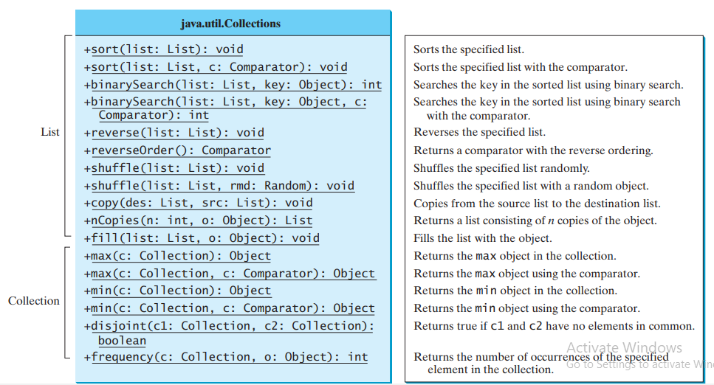
Static Methods for List and Collections

Slide 26
Vector and Stack Classes
The Collections class contains static methods to perform common operations in a collection and a list.
The Collections class contains the sort, binarySearch, reverse, shuffle, copy, and fill methods for lists, and max, min, disjoint, and frequency methods for collections.
Vector is a subclass of AbstractList, and Stack is a subclass of Vector in the Java API.
Vector is the same as ArrayList, except that it contains synchronized methods for accessing and modifying the vector. Synchronized methods can prevent data corruption when a vector is accessed and modified by two or more threads concurrently.

Slide 27
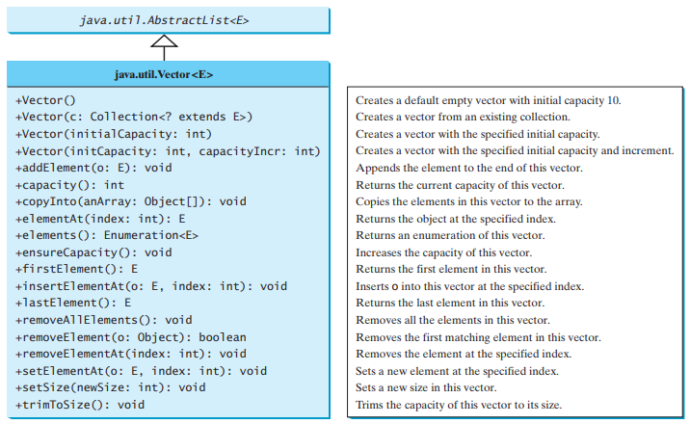
Vector Classes

Slide 28
Vector Classes
// Java Program to Add Elements in Vector Class
import java.util.*;
class Main {
public static void main(String[] arg)
{
Vector v1 = new Vector();
//Vector<Integer> v2 = new Vector<Integer>();
v1.add(1);
v1.add(2);
v1.add("Hi");
v1.add("Hello");
v1.add(3);
System.out.println("Vector v1 is " + v1);
}
}

Slide 29
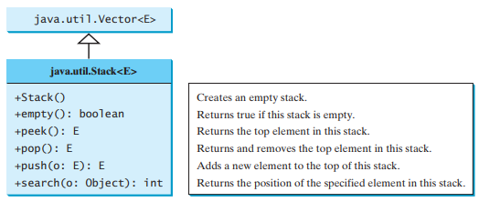
Stack Classes
In the Java Collections Framework, Stack is implemented as an extension of Vector.
Stack follows LIFO

Slide 30
Stack Classes
// Java program to add & remove the elements in the stack
import java.util.*;
class Main {
public static void main(String[] args)
{
Stack stack1 = new Stack();
stack1.push(4);
stack1.push("All");
stack1.push(“Hello");
System.out.println(stack1);
stack1.pop();
System.out.println(stack1);
}
}

Slide 31
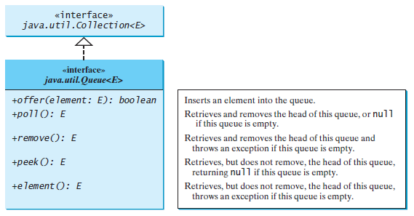
Queue
The Queue interface extends java.util.Collection with additional insertion, extraction, and inspection operations.
A queue is a first-in, first-out data structure.
Elements are appended to the end of the queue and are removed from the beginning of the queue.
offer() and add() both methods can be used to
Insert elements into queue.

Slide 32
Queue
import java.util.*;
class Main {
public static void main(String[] args) {
Queue<Integer> q = new LinkedList<>();
// offer elements to the Queue
q.offer(1); //q.add(1);
q.offer(2); q.offer(3); System.out.println("Queue: " + q);
// Access elements of the Queue
int accessedNumber = q.peek();
System.out.println("Accessed Element: " + accessedNumber);
// Remove elements from the Queue
int removedNumber = q.poll();
System.out.println("Removed Element: " + removedNumber);
System.out.println("Updated Queue: " + q); }}

Slide 33
Priority Queue
By default, the priority queue orders its elements according to their natural ordering using Comparable.
The element with the least value is assigned the highest priority and thus is removed from the queue first.
If there are several elements with the same highest priority, the tie is broken arbitrarily.
You can also specify an ordering using Comparator in the constructor PriorityQueue(initialCapacity, comparator).

Slide 34
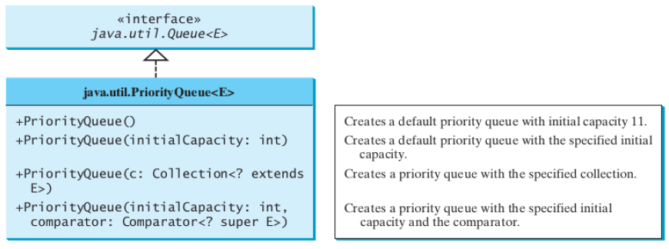
Priority Queue

Slide 35
Priority Queue
import java.util.*;
class Main{
public static void main(String args[]){
Queue<String> pq = new PriorityQueue<>();
//PriorityQueue<String> pq = new PriorityQueue<>();
pq.add("abcd");
pq.add("1234");
pq.add("java");
pq.add("catch");
pq.add("1");
System.out.println(pq); // Natural Ordering
}
}

Slide 36
Summary
ArrayList
Iterator vs ListIterator
LinkedList
Vector
Stack
Queue
PriorityQueue

Slide 37

END OF UNIT - 10

